Slide 1
Навигируемся в Compose
Игорь Кареньков

Slide 2

Игорь Кареньков
6 лет в android разработке
TeamLead Mobile-Core @ hh.ru
В свободное время лазаю по скалам 🧗🏻‍♂️
@karenkovigor
KarenkovID

Slide 3
1
Зачем нам библиотеки навигации в Compose?
2
Что мы хотим от навигации?
3
Краткий обзор библиотек навигации
4
Что выбрали?
5
Итоги
Notes:
Справа есть qr-код, там вся презентация. пока вы сканируете, я расскажу, о чём сегодня говорим

Slide 4
Почему бы тупо
не нарисовать state?

Slide 5
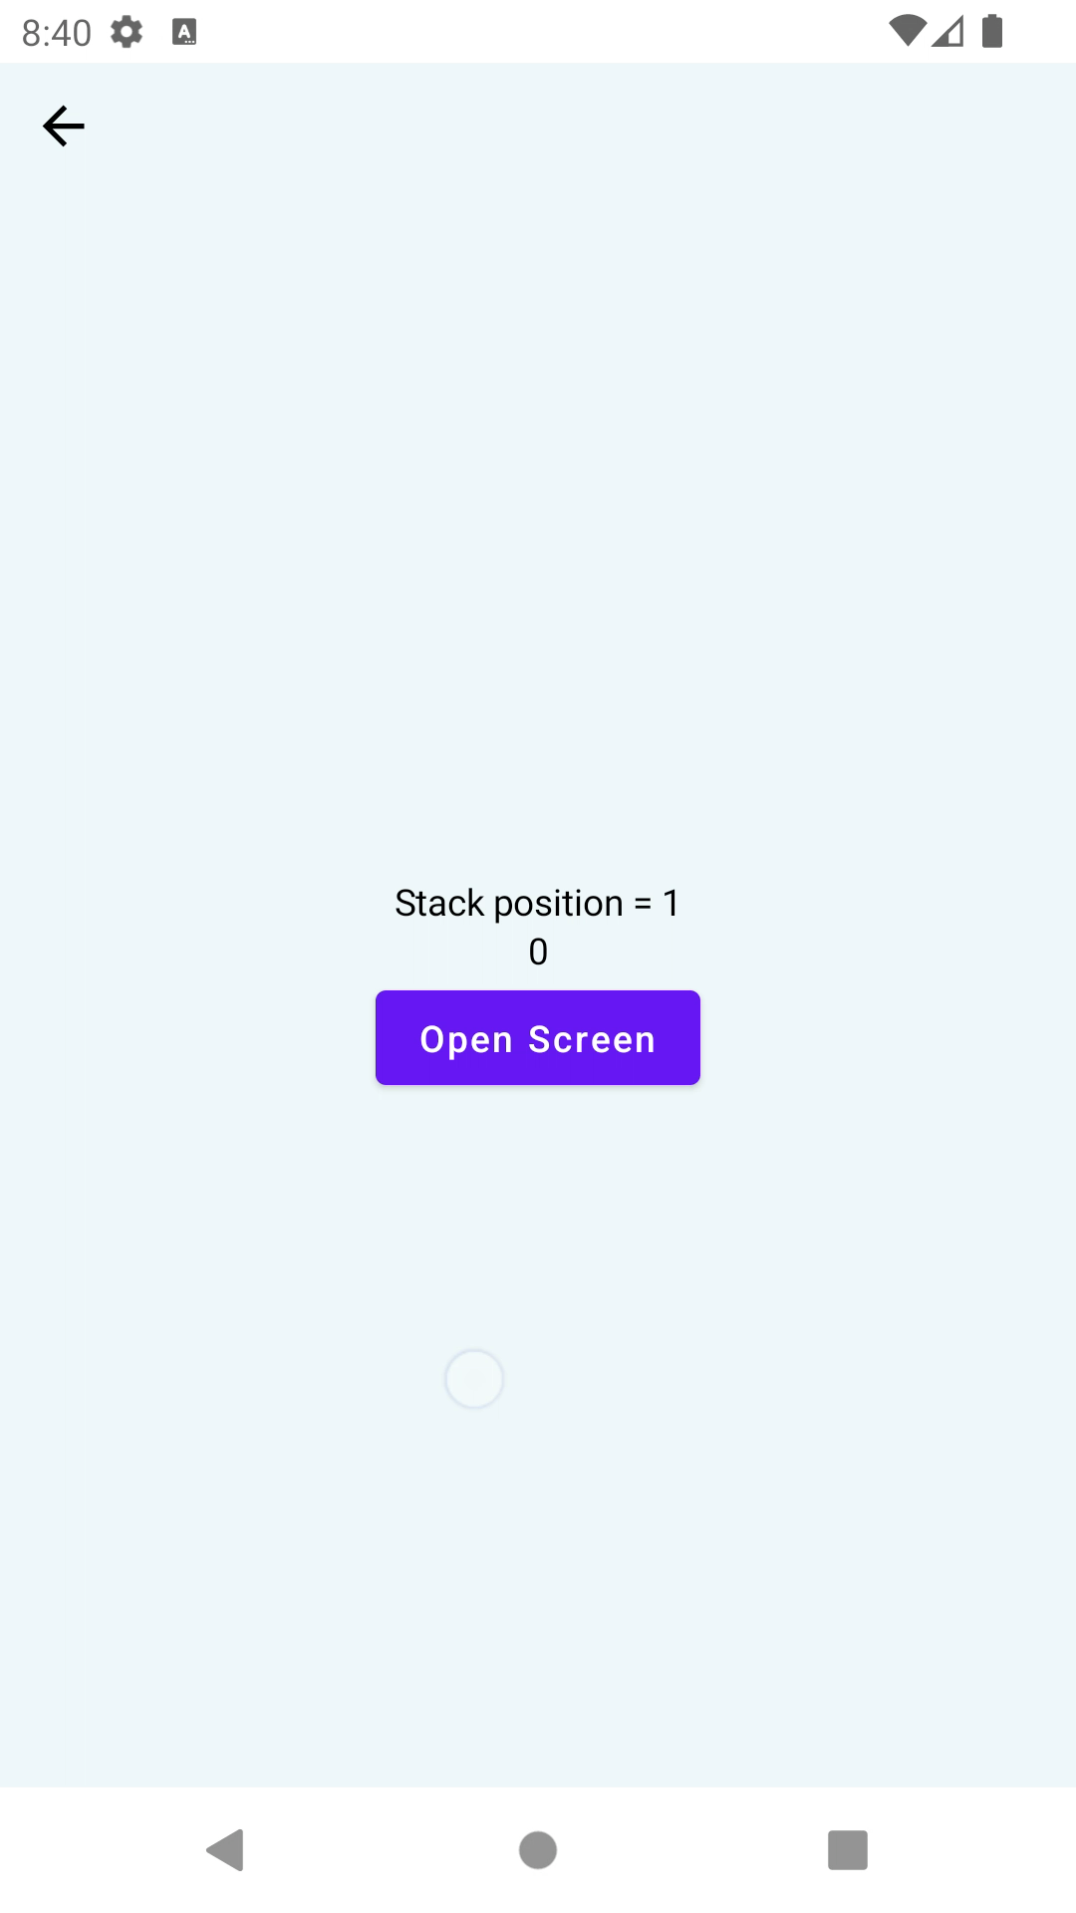

Slide 6
@Parcelize
internal class ScreenState(
val screenPos: Int,
) : Parcelable {
@Composable
fun Content() {
val navigateForward = LocalNavigateForward.current
ScreenWithButtons(
buttons = listOf("Open Screen" to navigateForward),
screenTitle = "Stack position = $screenPos",
modifier = Modifier
.randomBackground()
.fillMaxSize()
)
}
}

Slide 7
@Parcelize
internal class ScreenState(
val screenPos: Int,
) : Parcelable {
@Composable
fun Content() {
val navigateForward = LocalNavigateForward.current
ScreenWithButtons(
buttons = listOf("Open Screen" to navigateForward),
screenTitle = "Stack position = $screenPos",
modifier = Modifier
.randomBackground()
.fillMaxSize()
)
}
}

Slide 8
@Parcelize
internal class ScreenState(
val screenPos: Int,
) : Parcelable {
@Composable
fun Content() {
val navigateForward = LocalNavigateForward.current
ScreenWithButtons(
buttons = listOf("Open Screen" to navigateForward),
screenTitle = "Stack position = $screenPos",
modifier = Modifier
.randomBackground()
.fillMaxSize()
)
}
}

Slide 9
@Parcelize
internal class ScreenState(
val screenPos: Int,
) : Parcelable {
@Composable
fun Content() {
val navigateForward = LocalNavigateForward.current
ScreenWithButtons(
buttons = listOf("Open Screen" to navigateForward),
screenTitle = "Stack position = $screenPos",
modifier = Modifier
.composed {
val backgroundColorInt = rememberSaveable { Random.nextInt() }
val backgroundColor = remember { Color(backgroundColorInt) }
then(Modifier.background(backgroundColor))
}
.fillMaxSize()
)
}
}

Slide 10
@Parcelize
internal data class NavigationState<T : Parcelable>(
val stack: List<T>,
) : Parcelable

Slide 11
@Composable
internal fun SelfMadeNavigation() {
var navigationState: NavigationState<ScreenState> by rememberSaveable {
mutableStateOf(NavigationState(listOf(ScreenState(1))))
}
...
}

Slide 12
@Composable
internal fun SelfMadeNavigation() {
var navigationState: NavigationState<ScreenState> by rememberSaveable {
mutableStateOf(NavigationState(listOf(ScreenState(1))))
}
...
}

Slide 13
@Composable
internal fun SelfMadeNavigation() {
var navigationState: NavigationState<ScreenState> by rememberSaveable {
mutableStateOf(NavigationState(listOf(ScreenState(1))))
}
BackHandler(enabled = navigationState.stack.size > 1) {
navigationState = navigationState.copy(
stack = navigationState.stack.dropLast(1)
)
}
...
}

Slide 14
@Composable
internal fun SelfMadeNavigation() {
var navigationState: NavigationState<ScreenState> by rememberSaveable {
mutableStateOf(NavigationState(listOf(ScreenState(1))))
}
BackHandler(enabled = navigationState.stack.size > 1) {
navigationState = navigationState.copy(
stack = navigationState.stack.dropLast(1)
)
}
val renderScreen by remember {
derivedStateOf { navigationState.stack.last() }
}
...
}

Slide 15
@Composable
internal fun SelfMadeNavigation() {
...
val renderScreen by remember {
derivedStateOf { navigationState.stack.last() }
}
renderScreen.Content()
}

Slide 16
@Composable
internal fun SelfMadeNavigation() {
...
val renderScreen by remember {
derivedStateOf { navigationState.stack.last() }
}
CompositionLocalProvider(
LocalNavigateForward provides {
navigationState = navigationState.copy(
stack = navigationState.stack +
ScreenState(renderScreen.screenPos + 1)
)
}
) {
renderScreen.Content()
}
}

Slide 17
@Composable
internal fun SelfMadeNavigation() {
...
val renderScreen by remember {
derivedStateOf { navigationState.stack.last() }
}
CompositionLocalProvider(
LocalNavigateForward provides {
navigationState = navigationState.copy(
stack = navigationState.stack +
ScreenState(renderScreen.screenPos + 1)
)
}
) {
renderScreen.Content()
}
}

Slide 18
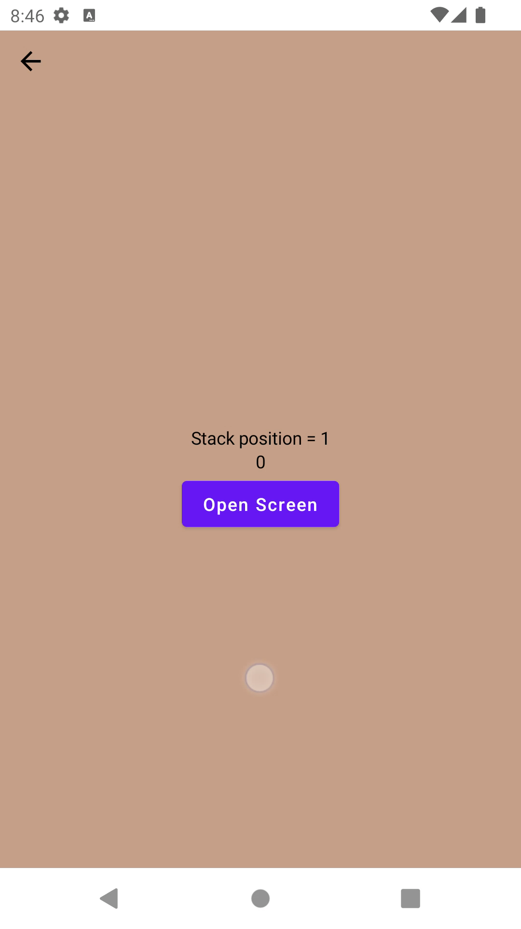

Slide 19
rememberSaveable не работают*

Slide 20
Как работает
rememberSaveable?

Slide 21
@Composable
fun <T : Any> rememberSaveable(
vararg inputs: Any?,
saver: Saver<T, out Any> = autoSaver(),
key: String? = null,
init: () -> T
): T {
// key is the one provided by the user or the one generated by the compose runtime
val finalKey = if (!key.isNullOrEmpty()) {
key
} else {
currentCompositeKeyHash.toString(MaxSupportedRadix)
}
@Suppress("UNCHECKED_CAST")
(saver as Saver<T, Any>)
val registry = LocalSaveableStateRegistry.current
// value is restored using the registry or created via [init] lambda

Slide 22
@Composable
fun <T : Any> rememberSaveable(
vararg inputs: Any?,
saver: Saver<T, out Any> = autoSaver(),
key: String? = null,
init: () -> T
): T {
// key is the one provided by the user or the one generated by the compose runtime
val finalKey = if (!key.isNullOrEmpty()) {
key
} else {
currentCompositeKeyHash.toString(MaxSupportedRadix)
}
@Suppress("UNCHECKED_CAST")
(saver as Saver<T, Any>)
val registry = LocalSaveableStateRegistry.current
// value is restored using the registry or created via [init] lambda

Slide 23
rememberSaveable
override fun SaveableStateProvider(key: Any, content: @Composable () -> Unit) {
ReusableContent(key) {
val registryHolder = remember {
require(parentSaveableStateRegistry?.canBeSaved(key) ?: true) {
"Type of the key $key is not supported. On Android you can only use types " +
"which can be stored inside the Bundle."
}
RegistryHolder(key)
}
CompositionLocalProvider(
LocalSaveableStateRegistry provides registryHolder.registry,
content = content
)

Slide 24
rememberSaveable
override fun SaveableStateProvider(key: Any, content: @Composable () -> Unit) {
ReusableContent(key) {
val registryHolder = remember {
require(parentSaveableStateRegistry?.canBeSaved(key) ?: true) {
"Type of the key $key is not supported. On Android you can only use types " +
"which can be stored inside the Bundle."
}
RegistryHolder(key)
}
CompositionLocalProvider(
LocalSaveableStateRegistry provides registryHolder.registry,
content = content
)

Slide 25
rememberSaveable
interface SaveableStateHolder {
/**
* Put your content associated with a [key] inside the [content]. This will automatically
* save all the states defined with [rememberSaveable] before disposing the content and will
* restore the states when you compose with this key again.
*
* @param key to be used for saving and restoring the states for the subtree. Note that on
* Android you can only use types which can be stored inside the Bundle.
*/
@Composable
fun SaveableStateProvider(key: Any, content: @Composable () -> Unit)
/**
* Removes the saved state associated with the passed [key].
*/
fun removeState(key: Any)
}

Slide 26
rememberSaveable
interface SaveableStateHolder {
/**
* Put your content associated with a [key] inside the [content]. This will automatically
* save all the states defined with [rememberSaveable] before disposing the content and will
* restore the states when you compose with this key again.
*
* @param key to be used for saving and restoring the states for the subtree. Note that on
* Android you can only use types which can be stored inside the Bundle.
*/
@Composable
fun SaveableStateProvider(key: Any, content: @Composable () -> Unit)
/**
* Removes the saved state associated with the passed [key].
*/
fun removeState(key: Any)
}

Slide 27
rememberSaveable
interface SaveableStateHolder {
/**
* Put your content associated with a [key] inside the [content]. This will automatically
* save all the states defined with [rememberSaveable] before disposing the content and will
* restore the states when you compose with this key again.
*
* @param key to be used for saving and restoring the states for the subtree. Note that on
* Android you can only use types which can be stored inside the Bundle.
*/
@Composable
fun SaveableStateProvider(key: Any, content: @Composable () -> Unit)
/**
* Removes the saved state associated with the passed [key].
*/
fun removeState(key: Any)
}

Slide 28
Все библиотеки под капотом используют SaveableStateHolder

Slide 29
А что если
задать key?

Slide 30
@Parcelize
internal class FixedScreenState(
val screenPos: Int,
val key: String = UUID.randomUUID().toString(),
) : Parcelable
@Composable
internal fun FixedSelfMadeNavigation() {
...
val saveableStateHolder = rememberSaveableStateHolder()
saveableStateHolder.SaveableStateProvider(key = renderState.key) {
ScreenWithButtons(
…
)
}
}

Slide 31
@Parcelize
internal class FixedScreenState(
val screenPos: Int,
val key: String = UUID.randomUUID().toString(),
) : Parcelable
@Composable
internal fun FixedSelfMadeNavigation() {
...
val saveableStateHolder = rememberSaveableStateHolder()
saveableStateHolder.SaveableStateProvider(key = renderState.key) {
ScreenWithButtons(
…
)
}
}

Slide 33
Self-made: проблемы
1
Ручное управление состоянием
2
Model для экрана с LifeCycle нужно писать самому
3
Нужно самостоятельно придумать дизайн
4
И это лишь верхушка айсберга

Slide 34
Может просто выберем
библиотеку?

Slide 35
По каким критериям оценивать?

Slide 36
Что мы хотим от навигации
1
Поддержка базовых команд навигации
2
Поддержка манипуляций со стэком
3
Корректность
4
Наличие модели экрана
5
Возможность постепенной интеграции

Slide 37
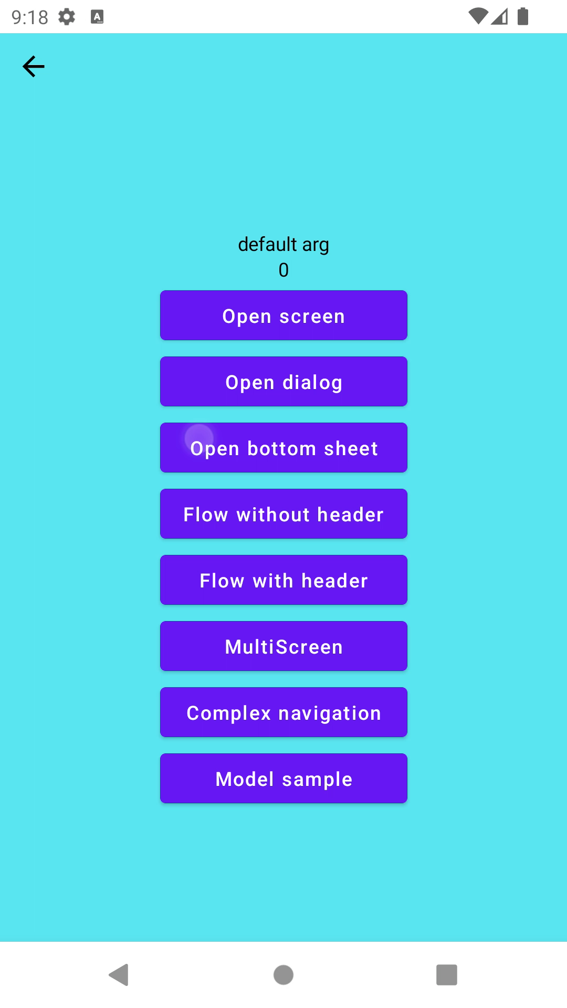
1. Функционал навигации
1
Открытие/Закрытие экрана
2
Вложенная навигация
3
Мультистек
4
Диалог
5
Bottom Sheet
6
Анимации
7
Модель экрана

Slide 38
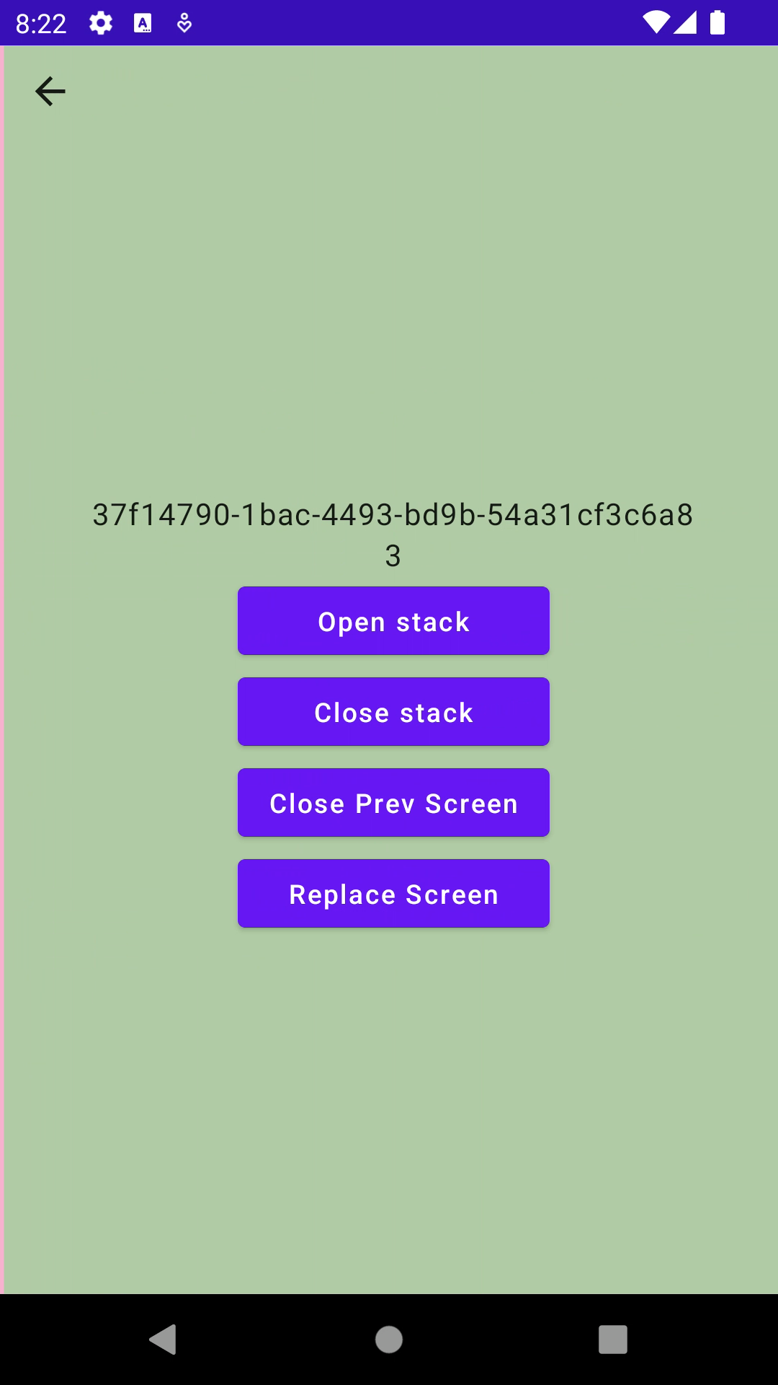
2. Навигация через состояние
1
Установка произвольного состояния
2
Получение состояния навигации

Slide 39
2*. Сложная навигация
1
Открытие стека экранов
2
Закрытие стека экранов
3
Закрытие отдельных экранов
4
Получение состояния навигации

Slide 40
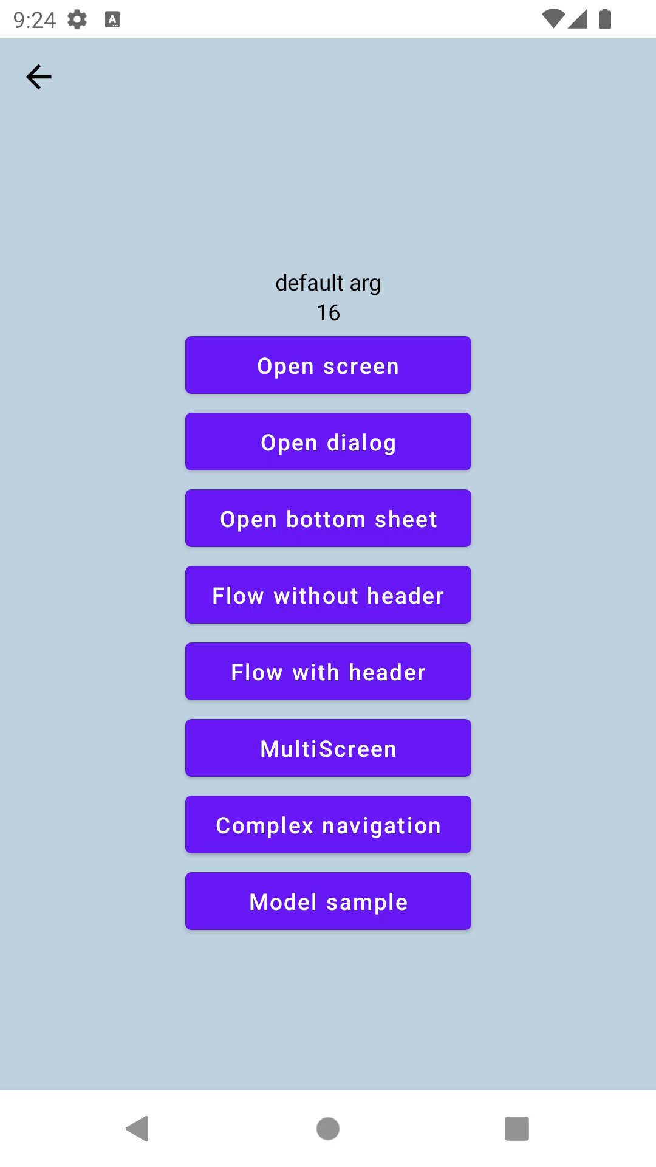
3. Корректность
1
Поворот экрана
2
Activity death
3
Process death

Slide 41
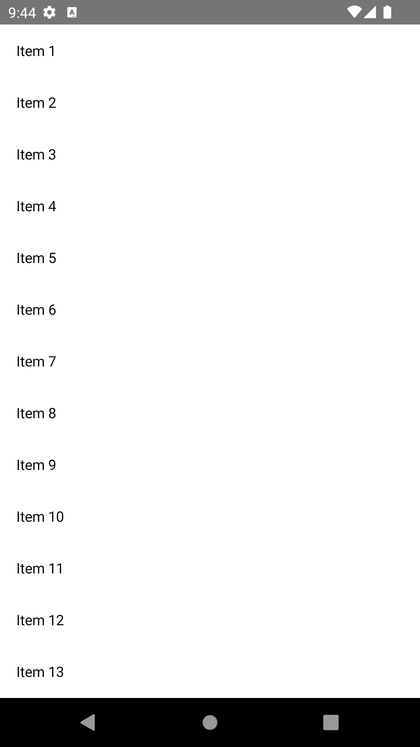
4. Модель экрана
1
Dispose модели экрана
2
LifeCycle для аналитики
3
Восстановление состояния после
Activity/Process death

Slide 42
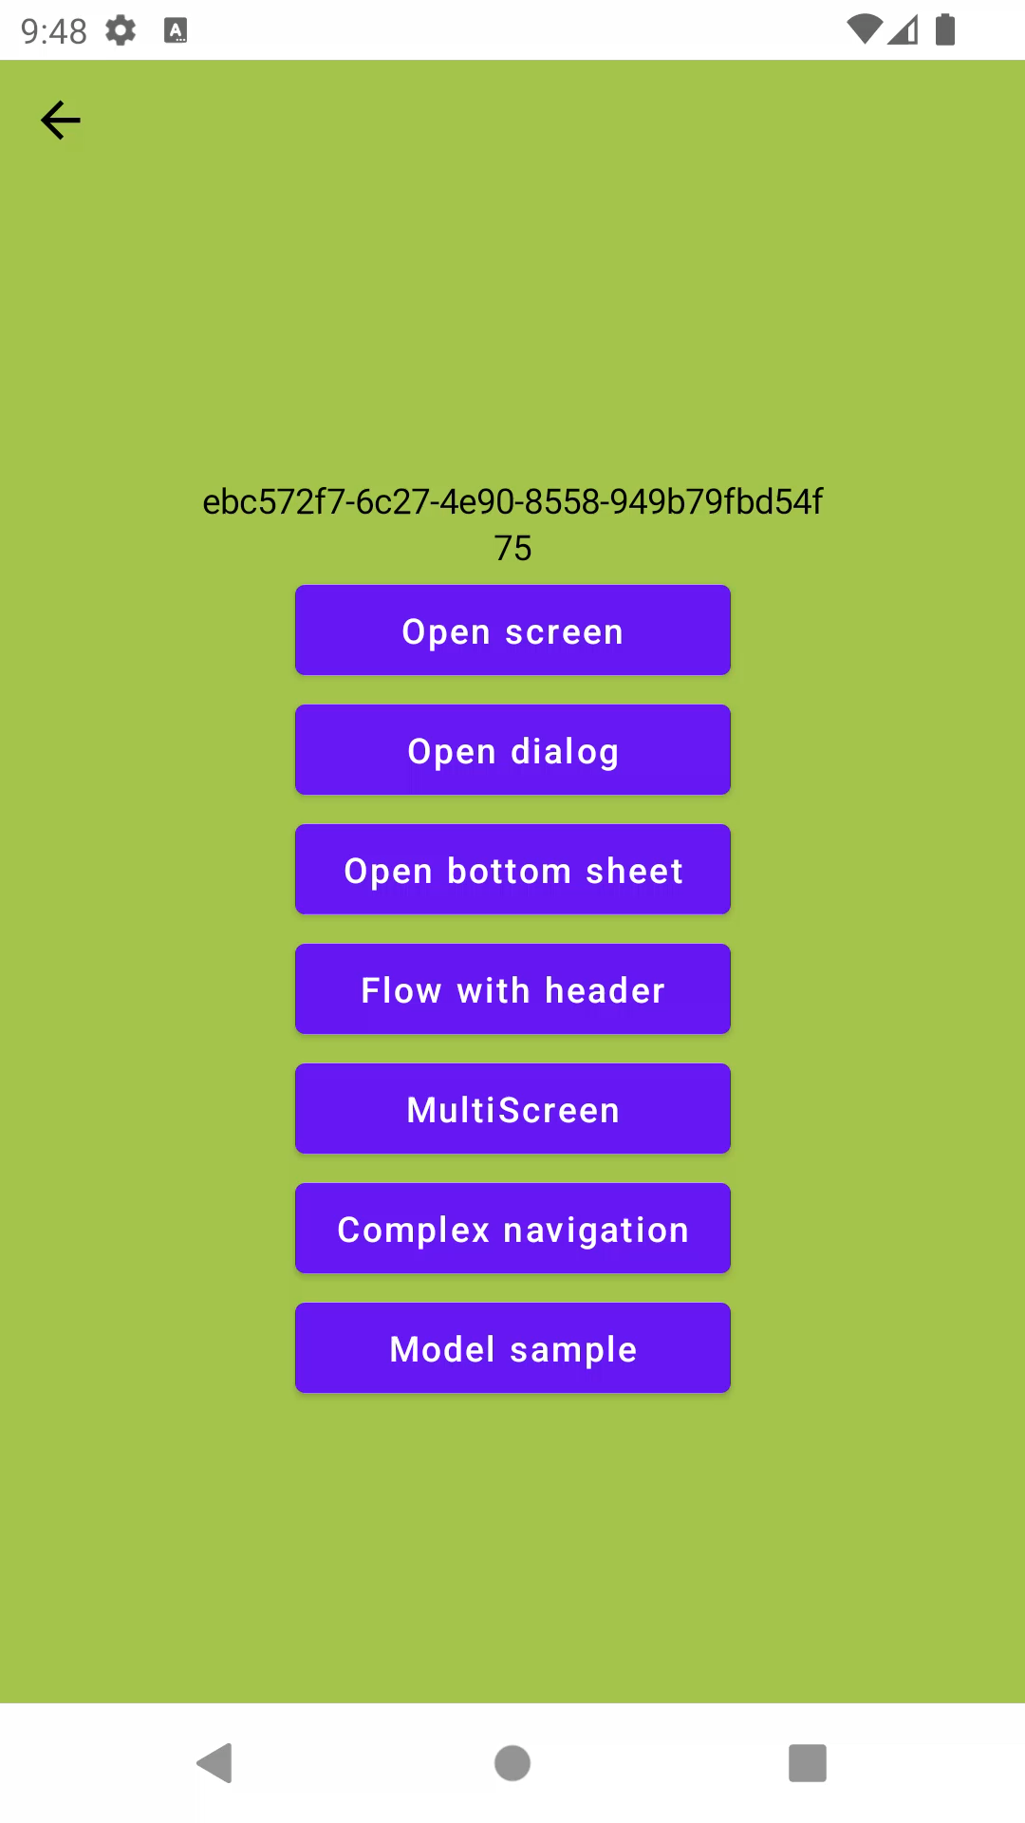
5. Декомпозиция навигации
1
Вложенная
2
В отдельном модуле
3
Внутри fragment

Slide 43
6. Интеграция с Fragment
1
Какие могут быть проблемы?
2
Как интегрировать?
3
Как открывать экраны на Fragment?

Slide 44
Что сравниваем
1
Google navigation
2
Appyx
3
Voyager
4
Modo
5
Odyssey

Slide 45
Готовим
Sample app

Slide 46
Sample App
https://github.com/hhru/jetpack-compose-navigation-research

Slide 47
Экраны
@Composable
fun SampleScreenContent(
openScreen: () -> Unit,
openDialog: () -> Unit,
openBottomSheet: () -> Unit,
startFlowWithoutHeader: (() -> Unit)?,
startFlowWithHeader: () -> Unit,
openMultiscreen: () -> Unit,
openScreenModel: () -> Unit,
openComplexNavigation: () -> Unit,
modifier: Modifier = Modifier,
screenTitle: String? = null,
) {...}

Slide 48
Экраны
@Composable
fun DialogContent(
openDialog: () -> Unit,
openScreen: (closeDialog: Boolean) -> Unit,
closeDialog: () -> Unit,
modifier: Modifier = Modifier,
screenTitle: String? = null,
) {...}

Slide 49
Обзор библиотек

Slide 50
Google Navigation

Slide 51
Google Navigation
https://developer.android.com/jetpack/compose/navigation

Slide 52
Google navigation component
1
Объявляем граф навигации в Compose
2
NavigationController - основное API
3
Аргументы и навигация через строки
4
Больно работать с аргументами
5
Поддержка анимаций, dialog, bottom sheet

Slide 53
Google navigation component
1
Объявляем граф навигации в Compose
2
NavigationController - основное API
3
Аргументы и навигация через строки
4
Больно работать с аргументами
5
Поддержка анимаций, dialog, bottom sheet

Slide 54
Google navigation component
1
Объявляем граф навигации в Compose
2
NavigationController - основное API
3
Аргументы и навигация через строки
4
Больно работать с аргументами
5
Поддержка анимаций, dialog, bottom sheet

Slide 55
Google navigation component
val navController = rememberNavController()
NavHost(
navController = navController,
startDestination = "screenNew?{title}"
) {
composable(
route = "screenNew?{title}",
arguments = listOf(
navArgument("title") {
type = NavType.StringType
defaultValue = "default arg"
}
)
) {
SampleScreenContent(navController, it)
}
composable(...)
}

Slide 56
Google navigation component
val navController = rememberNavController()
NavHost(
navController = navController,
startDestination = "screenNew?{title}"
) {
composable(
route = "screenNew?{title}",
arguments = listOf(
navArgument("title") {
type = NavType.StringType
defaultValue = "default arg"
}
)
) {
SampleScreenContent(navController, it)
}
composable(...)
}

Slide 57
Google navigation component
val navController = rememberNavController()
NavHost(
navController = navController,
startDestination = "screenNew?{title}"
) {
composable(
route = "screenNew?{title}",
arguments = listOf(
navArgument("title") {
type = NavType.StringType
defaultValue = "default arg"
}
)
) {
SampleScreenContent(navController, it)
}
composable(...)
}

Slide 58
Google navigation component
val navController = rememberNavController()
NavHost(
navController = navController,
startDestination = "screenNew?{title}"
) {
composable(
route = "screenNew?{title}",
arguments = listOf(
navArgument("title") {
type = NavType.StringType
defaultValue = "default arg"
}
)
) {
SampleScreenContent(navController, it)
}
composable(...)
}

Slide 59
Google navigation component
val navController = rememberNavController()
NavHost(
navController = navController,
startDestination = "screenNew?{title}"
) {
composable(
route = "screenNew?{title}",
arguments = listOf(
navArgument("title") {
type = NavType.StringType
defaultValue = "default arg"
}
)
) {
SampleScreenContent(navController, it)
}
composable(...)
}

Slide 60
Google navigation component
val navController = rememberNavController()
NavHost(
navController = navController,
startDestination = "screenNew?{title}"
) {
composable(
route = "screenNew?{title}",
arguments = listOf(
navArgument("title") {
type = NavType.StringType
defaultValue = "default arg"
}
)
) {
SampleScreenContent(navController, it)
}
composable(...)
}

Slide 61
composable(
...
) {
SampleScreenContent(navController, it)
}
flowGraphWithoutHeader(navController)
flowGraphWithHeader(navController)
multiScreenGraph(modifier)
bottomSheet(route = Screens.bottomSheet) {
SampleScreenContent(navController, it)
}
dialog(
...
) {
DialogContent(
...
)
}

Slide 62
Google navigation component
val navController = rememberNavController()
NavHost(
navController = navController,
startDestination = "screenNew?{title}"
) {
composable(
route = "screenNew?{title}",
arguments = listOf(
navArgument("title") {
type = NavType.StringType
defaultValue = "default arg"
}
)
) {
SampleScreenContent(navController, it)
}
composable(...)
}

Slide 63
Google navigation component
1
Объявляем граф навигации в Compose
2
NavigationController - основное API
3
Аргументы и навигация через строки
4
Больно работать с аргументами
5
Поддержка анимаций, dialog, bottom sheet

Slide 64
Google navigation component
val navController = rememberNavController()
NavHost(
navController = navController,
startDestination = "screenNew?{title}"
) {
composable(
route = "screenNew?{title}",
arguments = listOf(
navArgument("title") {
type = NavType.StringType
defaultValue = "default arg"
}
)
) {
SampleScreenContent(navController, it)
}
composable(...)
}

Slide 65
Google navigation component
val navController = rememberNavController()
NavHost(
navController = navController,
startDestination = "screenNew?{title}"
) {
composable(
route = "screenNew?{title}",
arguments = listOf(
navArgument("title") {
type = NavType.StringType
defaultValue = "default arg"
}
)
) {
SampleScreenContent(navController, it)
}
composable(...)
}

Slide 66
Google navigation component
val navController = rememberNavController()
NavHost(
navController = navController,
startDestination = "screenNew?{title}"
) {
composable(
route = "screenNew?{title}",
arguments = listOf(
navArgument("title") {
type = NavType.StringType
defaultValue = "default arg"
}
)
) {
SampleScreenContent(navController, it)
}
composable(...)
}

Slide 67
Google navigation component
val navController = rememberNavController()
NavHost(
navController = navController,
startDestination = "screenNew?{title}"
) {
composable(
route = "screenNew?{title}",
arguments = listOf(
navArgument("title") {
type = NavType.StringType
defaultValue = "default arg"
}
)
) {
SampleScreenContent(navController, it)
}
composable(...)
}

Slide 68
Как сделать чуточку лучше

Slide 69
object Sample {
const val titleArg = "title"
const val baseRoute = "screen"
const val route = "$baseRoute?{$titleArg}"
fun destination(title: String?) = "$baseRoute?${title.orEmpty()}"
}
composable(
route = Screens.Sample.route,
arguments = listOf(
navArgument(Screens.Sample.titleArg) {
type = NavType.StringType
defaultValue = "default arg"
}
)
) {
SampleScreenContent(navController, it)
}

Slide 70
object Sample {
const val titleArg = "title"
const val baseRoute = "screen"
const val route = "$baseRoute?{$titleArg}"
fun destination(title: String?) = "$baseRoute?${title.orEmpty()}"
}
composable(
route = Screens.Sample.route,
arguments = listOf(
navArgument(Screens.Sample.titleArg) {
type = NavType.StringType
defaultValue = "default arg"
}
)
) {
SampleScreenContent(navController, it)
}

Slide 71
Google navigation component
1
Объявляем граф навигации в Compose
2
NavigationController - основное API
3
Аргументы и навигация через строки
4
Больно работать с аргументами
5
Поддержка анимаций, dialog, bottom sheet

Slide 72
SampleScreenContent(
openScreen = { navController.openSample() },
openBottomSheet = { navController.navigate(Screens.bottomSheet) },
openDialog = {
navController.navigate(Screens.Dialog.destination(randomString()))
},
startFlowWithHeader = { navController.navigate(Screens.flowWithHeader) },
startFlowWithoutHeader = {
navController.navigate(Screens.flowWithoutHeader)
},
openMultiscreen = {
navController.navigate(Screens.multiScreen)
},
openScreenModel = {
navController.navigate(Screens.Sample.destination(null))
},
openComplexNavigation = { },
screenTitle = it.arguments?.getString(Screens.Sample.titleArg),
modifier = Modifier.fillMaxSize()
)

Slide 73
SampleScreenContent(
openScreen = { navController.navigate("screen?{${randomString()}}") },
openBottomSheet = { navController.navigate(Screens.bottomSheet) },
openDialog = {
navController.navigate(Screens.Dialog.destination(randomString()))
},
startFlowWithHeader = { navController.navigate(Screens.flowWithHeader) },
startFlowWithoutHeader = {
navController.navigate(Screens.flowWithoutHeader)
},
openMultiscreen = {
navController.navigate(Screens.multiScreen)
},
openScreenModel = {
navController.navigate(Screens.Sample.destination(null))
},
openComplexNavigation = { },
screenTitle = it.arguments?.getString(Screens.Sample.titleArg),
modifier = Modifier.fillMaxSize()
)

Slide 74
SampleScreenContent(
openScreen = { navController.openSample() },
openBottomSheet = { navController.navigate(Screens.bottomSheet) },
openDialog = {
navController.navigate(Screens.Dialog.destination(randomString()))
},
startFlowWithHeader = { navController.navigate(Screens.flowWithHeader) },
startFlowWithoutHeader = {
navController.navigate(Screens.flowWithoutHeader)
},
openMultiscreen = {
navController.navigate(Screens.multiScreen)
},
openScreenModel = {
navController.navigate(Screens.Sample.destination(null))
},
openComplexNavigation = { },
screenTitle = it.arguments?.getString(Screens.Sample.titleArg),
modifier = Modifier.fillMaxSize()
)

Slide 75
Когда нет compile time проверок

Slide 76
Google navigation component
1
Объявляем граф навигации в Compose
2
NavigationController - основное API
3
Аргументы и навигация через строки
4
Больно работать с аргументами
5
Поддержка анимаций, dialog, bottom sheet

Slide 77
Animation & Bottom Sheet
ModalBottomSheetLayout(bottomSheetNavigator = bottomSheetNavigator) {
AnimatedNavHost(
navController = navController,
startDestination = Screens.Sample.route,
modifier = modifier,
enterTransition = {
slideIntoContainer(
AnimatedContentScope.SlideDirection.Left,
animationSpec = tween()
)
},
exitTransition = {
slideOutOfContainer(
AnimatedContentScope.SlideDirection.Left,
animationSpec = tween()
)
},
...

Slide 78
Animation & Bottom Sheet
ModalBottomSheetLayout(bottomSheetNavigator = bottomSheetNavigator) {
AnimatedNavHost(
navController = navController,
startDestination = Screens.Sample.route,
modifier = modifier,
enterTransition = {
slideIntoContainer(
AnimatedContentScope.SlideDirection.Left,
animationSpec = tween()
)
},
exitTransition = {
slideOutOfContainer(
AnimatedContentScope.SlideDirection.Left,
animationSpec = tween()
)
},
...

Slide 79
Animation & Bottom Sheet
ModalBottomSheetLayout(bottomSheetNavigator = bottomSheetNavigator) {
AnimatedNavHost() {
bottomSheet(route = Screens.bottomSheet) {
SampleScreenContent(navController, it)
}
...

Slide 80
Google navigation: плюсы
1
Ну это же Гугл!
2
Просто реализовать
3
Поддержка VM из коробки
4
Встроенная поддержка deeplink*
5
Можно передавать лямбды в навигацию
5
Dialog & BootomSheet из коробки

Slide 81
Google navigation: минусы
1
Route - это просто строка
2
Передача аргументов - боль
3
Навигация через Composable fun
4
Нет compile checks
5
Сложная навигация - боль

Slide 82
Appyx (bumble)

Slide 83
Appyx
https://bumble-tech.github.io/appyx/

Slide 84
Экран - вершина графа

Slide 85
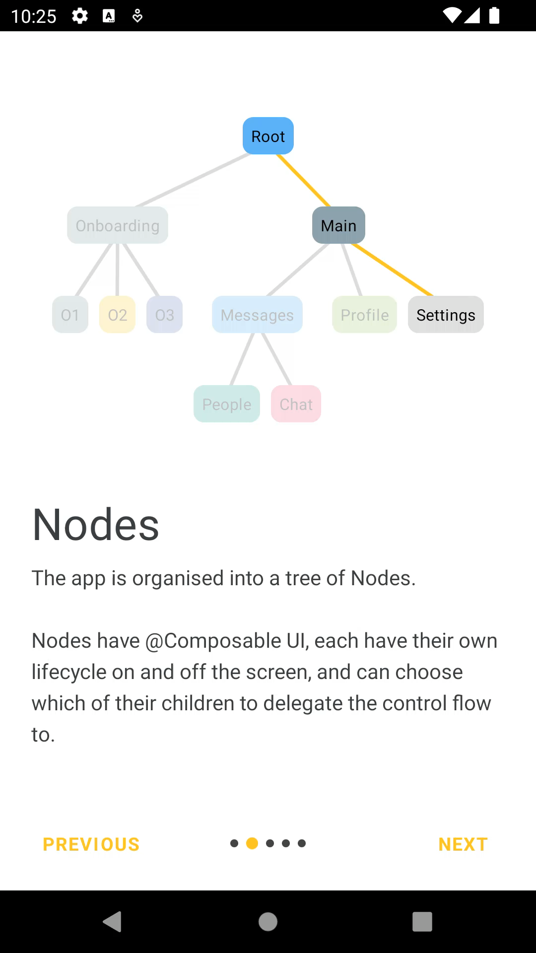

Slide 86
Appyx
1
Экран - это вершина графа (Node & ParentNode)
2
Навигация через NavModel
3
NavigationResolver & NavTarget для навигации
4
Гибкие анимации

Slide 87
Appyx
1
Экран - это вершина графа (Node & ParentNode)
2
Навигация через NavModel
3
NavigationResolver & NavTarget для навигации
4
Гибкие анимации

Slide 88
Appyx: Activity
class DemoActivity : BaseActivity(R.layout.activity_demo_root), IntegrationPointProvider {
override lateinit var appyxIntegrationPoint: ActivityIntegrationPoint
protected set
fun createIntegrationPoint(savedInstanceState: Bundle?) =
ActivityIntegrationPoint(
activity = this,
savedInstanceState = savedInstanceState
)
override fun onCreate(savedInstanceState: Bundle?) {
super.onCreate(savedInstanceState)
appyxIntegrationPoint = createIntegrationPoint(savedInstanceState)
}
…

Slide 89
Appyx: Fragment
override fun onCreateView(...): View =
ComposeView(requireContext()).apply {
setContent {
NodeHost(
integrationPoint = ActivityIntegrationPoint
.getIntegrationPoint(requireContext())
) {
StackNode(it)
}
}
}

Slide 90
Appyx: Fragment
override fun onCreateView(...): View =
ComposeView(requireContext()).apply {
setContent {
NodeHost(
integrationPoint = ActivityIntegrationPoint
.getIntegrationPoint(requireContext())
) {
StackNode(it)
}
}
}

Slide 91
Appyx: Fragment
override fun onCreateView(...): View =
ComposeView(requireContext()).apply {
setContent {
NodeHost(
integrationPoint = ActivityIntegrationPoint
.getIntegrationPoint(requireContext())
) {
StackNode(it)
}
}
}

Slide 92
Appyx: StackNode
internal class StackNode(
buildContext: BuildContext,
initialNavTarget: NavTarget = NavTarget.SampleScreen(randomString()),
private val backStack: BackStack<NavTarget> = BackStack(
initialElement = initialNavTarget,
savedStateMap = buildContext.savedStateMap,
),
) : ParentNode<NavTarget>(
navModel = backStack,
buildContext = buildContext
), Resolver<NavTarget> by NavigationResolver(
backStack,
{ backStack.pop() }
) {
@Composable
override fun View(modifier: Modifier) {
Children(
navModel = backStack
)
}
}

Slide 93
internal class StackNode(
buildContext: BuildContext,
initialNavTarget: NavTarget = NavTarget.SampleScreen(randomString()),
private val backStack: BackStack<NavTarget> = BackStack(
initialElement = initialNavTarget,
savedStateMap = buildContext.savedStateMap,
),
) : ParentNode<NavTarget>(
navModel = backStack,
buildContext = buildContext
), Resolver<NavTarget> by NavigationResolver(
backStack,
{ backStack.pop() }
) {
@Composable
override fun View(modifier: Modifier) {
Children(
navModel = backStack
)
}
}

Slide 94
internal class StackNode(
buildContext: BuildContext,
initialNavTarget: NavTarget = NavTarget.SampleScreen(randomString()),
private val backStack: BackStack<NavTarget> = BackStack(
initialElement = initialNavTarget,
savedStateMap = buildContext.savedStateMap,
),
) : ParentNode<NavTarget>(
navModel = backStack,
buildContext = buildContext
), Resolver<NavTarget> by NavigationResolver(
backStack,
{ backStack.pop() }
) {
@Composable
override fun View(modifier: Modifier) {
Children(
navModel = backStack
)
}
}

Slide 95
internal class SampleScreen(
buildContext: BuildContext,
private val title: String,
private val backStack: BackStack<NavTarget>,
) : Node(buildContext) {
@Composable
override fun View(modifier: Modifier) {
val showNotSupported = LocalShowNotSupported.current
SampleScreenContent(
openScreen = {
backStack.push(NavTarget.SampleScreen(randomString()))
},
...
screenTitle = title,
modifier = Modifier.fillMaxSize()
)
}
}

Slide 96
internal class SampleScreen(
buildContext: BuildContext,
private val title: String,
private val backStack: BackStack<NavTarget>,
) : Node(buildContext) {
@Composable
override fun View(modifier: Modifier) {
val showNotSupported = LocalShowNotSupported.current
SampleScreenContent(
openScreen = {
backStack.push(NavTarget.SampleScreen(randomString()))
},
...
screenTitle = title,
modifier = Modifier.fillMaxSize()
)
}
}

Slide 97
internal class SampleScreen(
buildContext: BuildContext,
private val title: String,
private val backStack: BackStack<NavTarget>,
) : Node(buildContext) {
@Composable
override fun View(modifier: Modifier) {
val showNotSupported = LocalShowNotSupported.current
SampleScreenContent(
openScreen = {
backStack.push(NavTarget.SampleScreen(randomString()))
},
...
screenTitle = title,
modifier = Modifier.fillMaxSize()
)
}
}

Slide 98
internal class SampleScreen(
buildContext: BuildContext,
private val title: String,
private val backStack: BackStack<NavTarget>,
) : Node(buildContext) {
@Composable
override fun View(modifier: Modifier) {
val showNotSupported = LocalShowNotSupported.current
SampleScreenContent(
openScreen = {
backStack.push(NavTarget.SampleScreen(randomString()))
},
...
screenTitle = title,
modifier = Modifier.fillMaxSize()
)
}
}

Slide 99
Appyx
1
Экран - это вершина графа (Node & ParentNode)
2
Навигация через NavModel
3
NavigationResolver & NavTarget для навигации
4
Гибкие анимации

Slide 100
internal class StackNode(
buildContext: BuildContext,
initialNavTarget: NavTarget = NavTarget.SampleScreen(randomString()),
private val backStack: BackStack<NavTarget> = BackStack(
initialElement = initialNavTarget,
savedStateMap = buildContext.savedStateMap,
),
) : ParentNode<NavTarget>(
navModel = backStack,
buildContext = buildContext
), Resolver<NavTarget> by NavigationResolver(
backStack,
{ backStack.pop() }
) {
@Composable
override fun View(modifier: Modifier) {
Children(
navModel = backStack
)
}
}

Slide 101
internal class StackNode(
buildContext: BuildContext,
initialNavTarget: NavTarget = NavTarget.SampleScreen(randomString()),
private val backStack: BackStack<NavTarget> = BackStack(
initialElement = initialNavTarget,
savedStateMap = buildContext.savedStateMap,
),
) : ParentNode<NavTarget>(
navModel = backStack,
buildContext = buildContext
), Resolver<NavTarget> by NavigationResolver(
backStack,
{ backStack.pop() }
) {
@Composable
override fun View(modifier: Modifier) {
Children(
navModel = backStack
)
}
}

Slide 102
internal class SampleScreen(
buildContext: BuildContext,
private val title: String,
private val backStack: BackStack<NavTarget>,
) : Node(buildContext) {
@Composable
override fun View(modifier: Modifier) {
val showNotSupported = LocalShowNotSupported.current
SampleScreenContent(
openScreen = {
backStack.push(NavTarget.SampleScreen(randomString()))
},
...
screenTitle = title,
modifier = Modifier.fillMaxSize()
)
}
}

Slide 103
Appyx
1
Экран - это вершина графа (Node & ParentNode)
2
Навигация через NavModel
3
NavigationResolver & NavTarget для навигации
4
Гибкие анимации

Slide 104
internal class StackNode(
buildContext: BuildContext,
initialNavTarget: NavTarget = NavTarget.SampleScreen(randomString()),
private val backStack: BackStack<NavTarget> = BackStack(
initialElement = initialNavTarget,
savedStateMap = buildContext.savedStateMap,
),
) : ParentNode<NavTarget>(
navModel = backStack,
buildContext = buildContext
), Resolver<NavTarget> by NavigationResolver(
backStack,
{ backStack.pop() }
) {
@Composable
override fun View(modifier: Modifier) {
Children(
navModel = backStack
)
}
}

Slide 105
internal class SampleScreen(
buildContext: BuildContext,
private val title: String,
private val backStack: BackStack<NavTarget>,
) : Node(buildContext) {
@Composable
override fun View(modifier: Modifier) {
val showNotSupported = LocalShowNotSupported.current
SampleScreenContent(
openScreen = {
backStack.push(NavTarget.SampleScreen(randomString()))
},
...
screenTitle = title,
modifier = Modifier.fillMaxSize()
)
}
}

Slide 106
internal sealed interface NavTarget : Parcelable {
@Parcelize
data class SampleScreen(
val tittle: String,
) : NavTarget
@Parcelize
data class ComplexNavigation(
val title: String,
) : NavTarget
@Parcelize
data class Stack(
val initialNavTarget: NavTarget = SampleScreen(randomString()),
) : NavTarget
@Parcelize
object MultiStack : NavTarget
@Parcelize
data class Flow(val firstScreenTitle: String) : NavTarget
}

Slide 107
internal class NavigationResolver(
private val stack: BackStack<NavTarget>,
private val onBack: () -> Unit,
) : Resolver<NavTarget> {
override fun resolve(navTarget: NavTarget, buildContext: BuildContext): Node =
when (navTarget) {
is NavTarget.SampleScreen ->
SampleScreen(buildContext, navTarget.tittle, stack)
is NavTarget.ComplexNavigation ->
ComplexNavigationScreen(buildContext, navTarget.title, stack)
is NavTarget.Stack ->
StackNode(buildContext, navTarget.initialNavTarget)
is NavTarget.MultiStack ->
MultiStackScreen(buildContext, 1)
is NavTarget.Flow ->
FlowNavigationScreen(buildContext, navTarget.firstScreenTitle, onBack)
}
}

Slide 108
internal class NavigationResolver(
private val stack: BackStack<NavTarget>,
private val onBack: () -> Unit,
) : Resolver<NavTarget> {
override fun resolve(navTarget: NavTarget, buildContext: BuildContext): Node =
when (navTarget) {
is NavTarget.SampleScreen ->
SampleScreen(buildContext, navTarget.tittle, stack)
is NavTarget.ComplexNavigation ->
ComplexNavigationScreen(buildContext, navTarget.title, stack)
is NavTarget.Stack ->
StackNode(buildContext, navTarget.initialNavTarget)
is NavTarget.MultiStack ->
MultiStackScreen(buildContext, 1)
is NavTarget.Flow ->
FlowNavigationScreen(buildContext, navTarget.firstScreenTitle, onBack)
}
}

Slide 109
Appyx
1
Экран - это вершина графа (Node & ParentNode)
2
Навигация через NavModel
3
NavigationResolver & NavTarget для навигации
4
Гибкие анимации

Slide 110
Children(
navModel = backStack,
transitionHandler = rememberBackstackSlider(
clipToBounds = true,
transitionSpec = { spring(stiffness = Spring.StiffnessMediumLow) }
),
)

Slide 111
Children(
navModel = backStack,
transitionHandler = rememberBackstackSlider(
clipToBounds = true,
transitionSpec = { spring(stiffness = Spring.StiffnessMediumLow) }
),
)

Slide 112
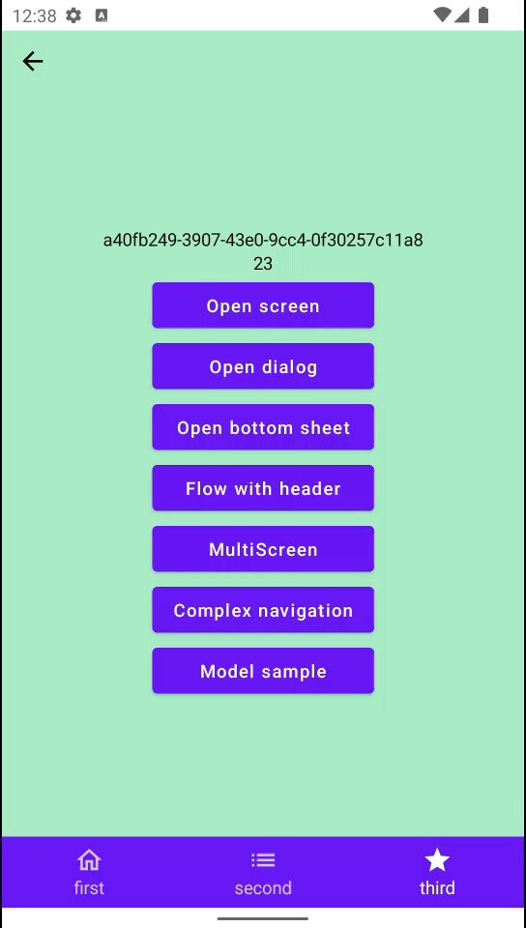
Appyx: визуальные баги

Slide 113
Appyx: плюсы
1
Строим дерево навигации*
2
Аргументы - типизированы
3
Навигация может быть чем угодно
4
Анимации
5
Сами можем контролировать стейт*

Slide 114
Appyx: минусы
1
Нельзя произвольно изменить состояние*
2
Boilerplate для открытия экрана детей
3
Нет поддержки dialog & bottom sheet
4
Стейт экрана - Flow, нужно об этом помнить
5
Очень не хватает доки по интеграции в Fragment

Slide 115
Voyager

Slide 116
Voyager
https://voyager.adriel.cafe/

Slide 117
Voyager
1
Navigator - основа библиотеки
2
Экран - это объект
3
Навигируемся
4
Интеграция с популярными библиотеками
5
Bottom sheet

Slide 118
Voyager
1
Navigator - основа библиотеки
2
Экран - это объект
3
Навигируемся
4
Интеграция с популярными библиотеками
5
Bottom sheet

Slide 119
Voyager: Fragment
override fun onCreateView(...): View =
ComposeView(requireContext()).apply {
setContent {
HHDynamicTheme {
Navigator(screen = SampleScreen(randomString())) {
SlideTransition(it)
}
}
}
}

Slide 120
Voyager: Fragment
override fun onCreateView(...): View =
ComposeView(requireContext()).apply {
setContent {
HHDynamicTheme {
Navigator(screen = SampleScreen(randomString())) {
SlideTransition(it)
}
}
}
}

Slide 121
Voyager: Fragment
override fun onCreateView(...): View =
ComposeView(requireContext()).apply {
setContent {
HHDynamicTheme {
Navigator(screen = SampleScreen(randomString())) {
SlideTransition(it)
}
}
}
}

Slide 122
Voyager
1
Navigator - основа библиотеки
2
Экран - это объект
3
Навигируемся
4
Интеграция с популярными библиотеками
5
Bottom sheet

Slide 123
Voyager
internal class SampleScreen(
private val title: String,
) : AndroidScreen() {
@Composable
override fun Content() {
...
}
}

Slide 124
Voyager
internal class SampleScreen(
private val title: String,
) : AndroidScreen() {
@Composable
override fun Content() {
...
}
}

Slide 125
Voyager
internal class SampleScreen(
private val title: String,
) : AndroidScreen() {
@Composable
override fun Content() {
...
}
}

Slide 126
Voyager
@Composable
override fun Content() {
val navigator = LocalNavigator.currentOrThrow
val bottomSheetNavigator = LocalBottomSheetNavigator.current
SampleScreenContent(
openScreen = { navigator.push(SampleScreen(title = randomString())) },
openDialog = { /* нет решения },
openBottomSheet = {
bottomSheetNavigator.show(SampleScreen(randomString()))
},
// этот просто копия кейса ниже, поэтому не будем его рисовать
startFlowWithoutHeader = null,
startFlowWithHeader = {
navigator.push(FlowNavigationScreen(randomString()))
},
openMultiscreen = { navigator.push(MultiStackScreen(0)) },
openScreenModel = { },
openComplexNavigation = { navigator.push(ComplexNavigationScreen()) },
screenTitle = title,
modifier = Modifier.fillMaxSize()
)
}

Slide 127
Voyager
1
Navigator - основа библиотеки
2
Экран - это объект
3
Навигируемся
4
Интеграция с популярными библиотеками
5
Bottom sheet

Slide 128
@Composable
override fun Content() {
val navigator = LocalNavigator.currentOrThrow
val bottomSheetNavigator = LocalBottomSheetNavigator.current
SampleScreenContent(
openScreen = { navigator.push(SampleScreen(title = randomString())) },
openDialog = { /* нет решения },
openBottomSheet = {
bottomSheetNavigator.show(SampleScreen(randomString()))
},
// этот просто копия кейса ниже, поэтому не будем его рисовать
startFlowWithoutHeader = null,
startFlowWithHeader = {
navigator.push(FlowNavigationScreen(randomString()))
},
openMultiscreen = { navigator.push(MultiStackScreen(0)) },
openScreenModel = { },
openComplexNavigation = { navigator.push(ComplexNavigationScreen()) },
screenTitle = title,
modifier = Modifier.fillMaxSize()
)
}

Slide 129
@Composable
override fun Content() {
val navigator = LocalNavigator.currentOrThrow
val bottomSheetNavigator = LocalBottomSheetNavigator.current
SampleScreenContent(
openScreen = { navigator.push(SampleScreen(title = randomString())) },
openDialog = { /* нет решения },
openBottomSheet = {
bottomSheetNavigator.show(SampleScreen(randomString()))
},
// этот просто копия кейса ниже, поэтому не будем его рисовать
startFlowWithoutHeader = null,
startFlowWithHeader = {
navigator.push(FlowNavigationScreen(randomString()))
},
openMultiscreen = { navigator.push(MultiStackScreen(0)) },
openScreenModel = { },
openComplexNavigation = { navigator.push(ComplexNavigationScreen()) },
screenTitle = title,
modifier = Modifier.fillMaxSize()
)
}

Slide 130
Просто создаём экран

Slide 131
Хочу что-нибудь
сложное

Slide 132
internal class MultiStackScreen(
private val firstSelectedTab: Int,
) : AndroidScreen() {
private val tabs = TABS.map {
StackTab()
}
@Composable
override fun Content() {
TabNavigator(tabs[firstSelectedTab]) { tabNavigator ->
val index = remember { derivedStateOf { tabs.indexOf(tabNavigator.current) } }
MultiStackScreenContent(
selectedPos = index.value,
onTabClick = {
tabNavigator.current = tabs[it]
}
) {
Box(Modifier.padding(it)) {
CurrentTab()
}
}
}
}
}

Slide 133
internal class MultiStackScreen(
private val firstSelectedTab: Int,
) : AndroidScreen() {
private val tabs = TABS.map {
StackTab()
}
@Composable
override fun Content() {
TabNavigator(tabs[firstSelectedTab]) { tabNavigator ->
val index = remember { derivedStateOf { tabs.indexOf(tabNavigator.current) } }
MultiStackScreenContent(
selectedPos = index.value,
onTabClick = {
tabNavigator.current = tabs[it]
}
) {
Box(Modifier.padding(it)) {
CurrentTab()
}
}
}
}
}

Slide 134
internal class MultiStackScreen(
private val firstSelectedTab: Int,
) : AndroidScreen() {
private val tabs = TABS.map {
StackTab()
}
@Composable
override fun Content() {
TabNavigator(tabs[firstSelectedTab]) { tabNavigator ->
val index = remember { derivedStateOf { tabs.indexOf(tabNavigator.current) } }
MultiStackScreenContent(
selectedPos = index.value,
onTabClick = {
tabNavigator.current = tabs[it]
}
) {
Box(Modifier.padding(it)) {
CurrentTab()
}
}
}
}
}

Slide 135
internal class MultiStackScreen(
private val firstSelectedTab: Int,
) : AndroidScreen() {
private val tabs = TABS.map {
StackTab()
}
@Composable
override fun Content() {
TabNavigator(tabs[firstSelectedTab]) { tabNavigator ->
val index = remember { derivedStateOf { tabs.indexOf(tabNavigator.current) } }
MultiStackScreenContent(
selectedPos = index.value,
onTabClick = {
tabNavigator.current = tabs[it]
}
) {
Box(Modifier.padding(it)) {
CurrentTab()
}
}
}
}
}

Slide 136
internal class MultiStackScreen(
private val firstSelectedTab: Int,
) : AndroidScreen() {
private val tabs = TABS.map {
StackTab()
}
@Composable
override fun Content() {
TabNavigator(tabs[firstSelectedTab]) { tabNavigator ->
val index = remember { derivedStateOf { tabs.indexOf(tabNavigator.current) } }
MultiStackScreenContent(
selectedPos = index.value,
onTabClick = {
tabNavigator.current = tabs[it]
}
) {
Box(Modifier.padding(it)) {
CurrentTab()
}
}
}
}
}

Slide 137
internal class MultiStackScreen(
private val firstSelectedTab: Int,
) : AndroidScreen() {
private val tabs = TABS.map {
StackTab()
}
@Composable
override fun Content() {
TabNavigator(tabs[firstSelectedTab]) { tabNavigator ->
val index = remember { derivedStateOf { tabs.indexOf(tabNavigator.current) } }
MultiStackScreenContent(
selectedPos = index.value,
onTabClick = {
tabNavigator.current = tabs[it]
}
) {
Box(Modifier.padding(it)) {
CurrentTab()
}
}
}
}
}

Slide 138
internal class MultiStackScreen(
private val firstSelectedTab: Int,
) : AndroidScreen() {
private val tabs = TABS.map {
StackTab()
}
@Composable
override fun Content() {
TabNavigator(tabs[firstSelectedTab]) { tabNavigator ->
val index = remember { derivedStateOf { tabs.indexOf(tabNavigator.current) } }
MultiStackScreenContent(
selectedPos = index.value,
onTabClick = {
tabNavigator.current = tabs[it]
}
) {
Box(Modifier.padding(it)) {
CurrentTab()
}
}
}
}
}

Slide 139
internal class StackTab : Tab {
override val key: ScreenKey = uniqueScreenKey
override val options: TabOptions
@Composable
get() {
// просто заглушка, т.к. по факту мы это не используем
return remember {
TabOptions(
index = 0u,
title = "",
icon = null
)
}
}
@Composable
override fun Content() {
Navigator(screen = SampleScreen(randomString()))
}
}

Slide 140
internal class StackTab : Tab {
override val key: ScreenKey = uniqueScreenKey
override val options: TabOptions
@Composable
get() {
// просто заглушка, т.к. по факту мы это не используем
return remember {
TabOptions(
index = 0u,
title = "",
icon = null
)
}
}
@Composable
override fun Content() {
Navigator(screen = SampleScreen(randomString()))
}
}

Slide 141
internal class StackTab : Tab {
override val key: ScreenKey = uniqueScreenKey
override val options: TabOptions
@Composable
get() {
// просто заглушка, т.к. по факту мы это не используем
return remember {
TabOptions(
index = 0u,
title = "",
icon = null
)
}
}
@Composable
override fun Content() {
Navigator(screen = SampleScreen(randomString()))
}
}

Slide 142
internal class StackTab : Tab {
override val key: ScreenKey = uniqueScreenKey
override val options: TabOptions
@Composable
get() {
// просто заглушка, т.к. по факту мы это не используем
return remember {
TabOptions(
index = 0u,
title = "",
icon = null
)
}
}
@Composable
override fun Content() {
Navigator(screen = SampleScreen(randomString()))
}
}

Slide 143
А что там с
Корректностью?

Slide 145
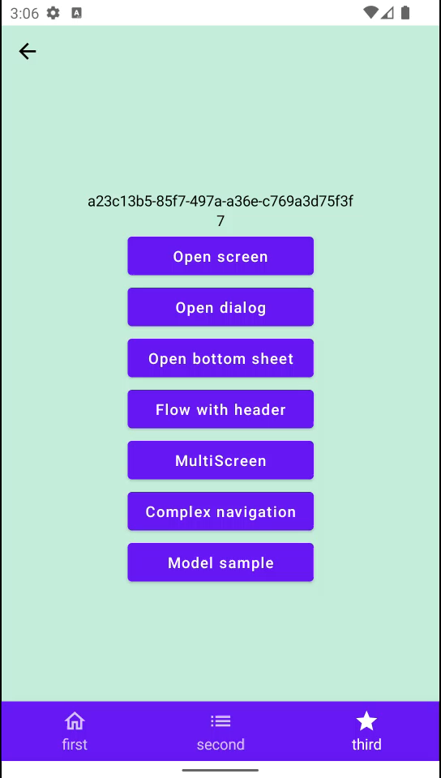
public abstract class AndroidScreen :
Screen, ScreenLifecycleProvider {
override val key: ScreenKey = uniqueScreenKey
}

Slide 146
public abstract class AndroidScreen :
Screen, ScreenLifecycleProvider {
override val key: ScreenKey = uniqueScreenKey
}
public val Screen.uniqueScreenKey: ScreenKey
get() = "Screen#${nextScreenKey.getAndIncrement()}"

Slide 147
public abstract class AndroidScreen :
Screen, ScreenLifecycleProvider {
override val key: ScreenKey = uniqueScreenKey
}
private val nextScreenKey = AtomicInt32(0)
public val Screen.uniqueScreenKey: ScreenKey
get() = "Screen#${nextScreenKey.getAndIncrement()}"

Slide 148
Voyager: плюсы
1
Простота открытия экранов
2
Аргументы - типизированы
3
Анимации
4
Поддержка множества способов создать
model экрана, в том числе VM, Koin и т.п.
5
Связка с LifeCycle

Slide 149
Voyager: минусы
1
Навигация внутри Composable fun
2
Баги, баги, баги
3
Нет поддержки dialog*
4
Почти не кастомизировать

Slide 150
Modo

Slide 151
Modo
https://github.com/terrakok/Modo

Slide 152
Навигация =
Состоянию

Slide 153
Modo
State
Reducer + Commands
Screen/Container

Slide 154
Modo
1
Fragment
2
ContainerScreen/Screen
3
Навигируемся
4
NavModel/ContainerScreen
5
Поддержка анимаций, dialog

Slide 155
Modo: Fragment
private var rootScreen: ModoStackScreen? = null
override fun onCreate(savedInstanceState: Bundle?) {
super.onCreate(savedInstanceState)
rootScreen = Modo.init(savedInstanceState, rootScreen) {
ModoStackScreen()
}
}
override fun onCreateView(...): View =
ComposeView(requireContext()).apply {
setContent {
rootScreen?.Content()
}
}
override fun onSaveInstanceState(outState: Bundle) {
super.onSaveInstanceState(outState)
Modo.save(outState, rootScreen)
}

Slide 156
Modo: Fragment
private var rootScreen: ModoStackScreen? = null
override fun onCreate(savedInstanceState: Bundle?) {
super.onCreate(savedInstanceState)
rootScreen = Modo.init(savedInstanceState, rootScreen) {
ModoStackScreen()
}
}
override fun onCreateView(...): View =
ComposeView(requireContext()).apply {
setContent {
rootScreen?.Content()
}
}
override fun onSaveInstanceState(outState: Bundle) {
super.onSaveInstanceState(outState)
Modo.save(outState, rootScreen)
}

Slide 157
Modo: Fragment
private var rootScreen: ModoStackScreen? = null
override fun onCreate(savedInstanceState: Bundle?) {
super.onCreate(savedInstanceState)
rootScreen = Modo.init(savedInstanceState, rootScreen) {
ModoStackScreen()
}
}
override fun onCreateView(...): View =
ComposeView(requireContext()).apply {
setContent {
rootScreen?.Content()
}
}
override fun onSaveInstanceState(outState: Bundle) {
super.onSaveInstanceState(outState)
Modo.save(outState, rootScreen)
}

Slide 158
Modo: Fragment
private var rootScreen: ModoStackScreen? = null
override fun onCreate(savedInstanceState: Bundle?) {
super.onCreate(savedInstanceState)
rootScreen = Modo.init(savedInstanceState, rootScreen) {
ModoStackScreen()
}
}
override fun onCreateView(...): View =
ComposeView(requireContext()).apply {
setContent {
rootScreen?.Content()
}
}
override fun onSaveInstanceState(outState: Bundle) {
super.onSaveInstanceState(outState)
Modo.save(outState, rootScreen)
}

Slide 159
Modo: Fragment
private var rootScreen: ModoStackScreen? = null
override fun onCreate(savedInstanceState: Bundle?) {
super.onCreate(savedInstanceState)
rootScreen = Modo.init(savedInstanceState, rootScreen) {
ModoStackScreen()
}
}
override fun onCreateView(...): View =
ComposeView(requireContext()).apply {
setContent {
rootScreen?.Content()
}
}
override fun onSaveInstanceState(outState: Bundle) {
super.onSaveInstanceState(outState)
Modo.save(outState, rootScreen)
}

Slide 160
Modo: Fragment
private var rootScreen: ModoStackScreen? = null
override fun onCreate(savedInstanceState: Bundle?) {
super.onCreate(savedInstanceState)
rootScreen = Modo.init(savedInstanceState, rootScreen) {
ModoStackScreen()
}
}
override fun onCreateView(...): View =
ComposeView(requireContext()).apply {
setContent {
rootScreen?.Content()
}
}
override fun onSaveInstanceState(outState: Bundle) {
super.onSaveInstanceState(outState)
Modo.save(outState, rootScreen)
}

Slide 161
Modo: Fragment
private var rootScreen: ModoStackScreen? = null
override fun onCreate(savedInstanceState: Bundle?) {
super.onCreate(savedInstanceState)
rootScreen = Modo.init(savedInstanceState, rootScreen) {
ModoStackScreen()
}
}
...
override fun onSaveInstanceState(outState: Bundle) {
super.onSaveInstanceState(outState)
Modo.save(outState, rootScreen)
}

Slide 162
Modo
1
Fragment
2
ContainerScreen/Screen
3
Навигируемся
4
NavModel/ContainerScreen
5
Поддержка анимаций, dialog

Slide 163
Modo: StackScreen
@Parcelize
internal class ModoStackScreen(
private val navModel: StackNavModel =
StackNavModel(SampleScreen(randomString())),
) : StackScreen(navModel) {
@Composable
override fun Content() {
TopScreenContent { SlideTransition() }
}
}

Slide 164
Modo: StackScreen
@Parcelize
internal class ModoStackScreen(
private val navModel: StackNavModel =
StackNavModel(SampleScreen(randomString())),
) : StackScreen(navModel) {
@Composable
override fun Content() {
TopScreenContent { SlideTransition() }
}
}

Slide 165
Modo: StackScreen
@Parcelize
internal class ModoStackScreen(
private val navModel: StackNavModel =
StackNavModel(SampleScreen(randomString())),
) : StackScreen(navModel) {
@Composable
override fun Content() {
TopScreenContent { SlideTransition() }
}
}

Slide 166
Modo: StackScreen
@Parcelize
internal class ModoStackScreen(
private val navModel: StackNavModel =
StackNavModel(SampleScreen(randomString())),
) : StackScreen(navModel) {
@Composable
override fun Content() {
TopScreenContent { SlideTransition() }
}
}

Slide 167
Modo: StackScreen
@Parcelize
internal class ModoStackScreen(
private val navModel: StackNavModel =
StackNavModel(SampleScreen(randomString())),
) : StackScreen(navModel) {
@Composable
override fun Content() {
TopScreenContent { SlideTransition() }
}
}

Slide 168
Modo: StackScreen
@Parcelize
internal class ModoStackScreen(
private val navModel: StackNavModel =
StackNavModel(SampleScreen(randomString())),
) : StackScreen(navModel) {
@Composable
override fun Content() {
TopScreenContent { SlideTransition() }
}
}

Slide 169
Modo: Screen
@Parcelize
internal class SampleScreen(
private val title: String,
override val screenKey: ScreenKey = generateScreenKey(),
) : Screen {
@Composable
override fun Content() {
val parent = LocalContainerScreen.current
SampleContent(i, parent)
}
}

Slide 170
Modo: Screen
@Parcelize
internal class SampleScreen(
private val title: String,
override val screenKey: ScreenKey = generateScreenKey(),
) : Screen {
@Composable
override fun Content() {
val parent = LocalContainerScreen.current
SampleContent(i, parent)
}
}

Slide 171
Modo: Screen
@Parcelize
internal class SampleScreen(
private val title: String,
override val screenKey: ScreenKey = generateScreenKey(),
) : Screen {
@Composable
override fun Content() {
val parent = LocalContainerScreen.current
SampleContent(i, parent)
}
}

Slide 172
Modo: Screen
@Parcelize
internal class SampleScreen(
private val title: String,
override val screenKey: ScreenKey = generateScreenKey(),
) : Screen {
@Composable
override fun Content() {
val parent = LocalContainerScreen.current
SampleContent(i, parent)
}
}

Slide 173
Modo: Screen
@Parcelize
internal class SampleScreen(
private val title: String,
override val screenKey: ScreenKey = generateScreenKey(),
) : Screen {
@Composable
override fun Content() {
val parent = LocalContainerScreen.current
SampleContent(i, parent)
}
}

Slide 174
Modo: Screen
@Parcelize
internal class SampleScreen(
private val title: String,
override val screenKey: ScreenKey = generateScreenKey(),
) : Screen {
@Composable
override fun Content() {
val parent = LocalContainerScreen.current
SampleContent(i, parent)
}
}

Slide 175
Modo: Screen
@Parcelize
internal class SampleScreen(
private val title: String,
override val screenKey: ScreenKey = generateScreenKey(),
) : Screen {
@Composable
override fun Content() {
val parent = LocalContainerScreen.current
SampleContent(i, parent)
}
}

Slide 176
Modo
1
Fragment
2
ContainerScreen/Screen
3
Навигируемся
4
NavModel/ContainerScreen
5
Поддержка анимаций, dialog

Slide 177
Modo: навигируемся
@Composable
override fun Content() {
val parent = LocalContainerScreen.current
val showNotSupported = LocalShowNotSupported.current
SampleScreenContent(
openScreen = { parent.forward(SampleScreen(randomString())) },
openDialog = { parent.forward(SampleDialogScreen(randomString())) },
openBottomSheet = { showNotSupported() },
// этот кейс просто копия кейса ниже, поэтому не будем его рисовать
startFlowWithoutHeader = null,
startFlowWithHeader = {
parent.forward(FlowNavigationScreen(randomString()))
},
openMultiscreen = { parent.forward(MultiStackScreen(1)) },
openScreenModel = { },
openComplexNavigation = {
parent.forward(ComplexNavigationScreen(randomString()))
},
screenTitle = title,
modifier = Modifier.fillMaxSize()
)
}

Slide 178
Modo: навигируемся
@Composable
override fun Content() {
val parent = LocalContainerScreen.current
val showNotSupported = LocalShowNotSupported.current
SampleScreenContent(
openScreen = { parent.forward(SampleScreen(randomString())) },
openDialog = { parent.forward(SampleDialogScreen(randomString())) },
openBottomSheet = { showNotSupported() },
// этот кейс просто копия кейса ниже, поэтому не будем его рисовать
startFlowWithoutHeader = null,
startFlowWithHeader = {
parent.forward(FlowNavigationScreen(randomString()))
},
openMultiscreen = { parent.forward(MultiStackScreen(1)) },
openScreenModel = { },
openComplexNavigation = {
parent.forward(ComplexNavigationScreen(randomString()))
},
screenTitle = title,
modifier = Modifier.fillMaxSize()
)
}

Slide 179
Modo: навигируемся
@Composable
override fun Content() {
val parent = LocalContainerScreen.current
val showNotSupported = LocalShowNotSupported.current
SampleScreenContent(
openScreen = { parent.forward(SampleScreen(randomString())) },
openDialog = { parent.forward(SampleDialogScreen(randomString())) },
openBottomSheet = { showNotSupported() },
// этот кейс просто копия кейса ниже, поэтому не будем его рисовать
startFlowWithoutHeader = null,
startFlowWithHeader = {
parent.forward(FlowNavigationScreen(randomString()))
},
openMultiscreen = { parent.forward(MultiStackScreen(1)) },
openScreenModel = { },
openComplexNavigation = {
parent.forward(ComplexNavigationScreen(randomString()))
},
screenTitle = title,
modifier = Modifier.fillMaxSize()
)
}

Slide 180
Modo
1
Fragment
2
ContainerScreen/Screen
3
Навигируемся
4
NavModel/ContainerScreen
5
Поддержка анимаций, dialog

Slide 181
Modo: NavModel
fun NavigationContainer<StackState>.forward(
screen: Screen,
vararg screens: Screen
) = dispatch(Forward(screen, *screens))

Slide 182
Modo: NavModel
fun NavigationContainer<StackState>.forward(
screen: Screen,
vararg screens: Screen
) = dispatch(Forward(screen, *screens))
interface NavigationContainer<State : NavigationState> {
val navigationState: State
fun dispatch(action: NavigationAction)
}

Slide 183
Modo: NavModel
...
interface NavigationContainer<State : NavigationState> {
val navigationState: State
fun dispatch(action: NavigationAction)
}
@Parcelize
data class StackState(
val stack: List<Screen> = emptyList(),
) : NavigationState, Parcelable {
override fun getChildScreens(): List<Screen> = stack
}

Slide 184
Modo: NavModel
abstract class ContainerScreen<State : NavigationState>(
private val navModel: NavModel<State>
) : Screen, NavigationContainer<State> by navModel {
abstract val reducer: NavigationReducer<State>
...
init {
navModel.init(
reducerProvider = { reducer },
renderer = ComposeRenderer(this)
)
}
@Composable
protected fun InternalContent(
screen: Screen,
content: RendererContent<State> = defaultRendererContent
) {
val composeRenderer = renderer as ComposeRenderer
composeRenderer.Content(screen, content)
}
}

Slide 185
Modo: NavModel
abstract class ContainerScreen<State : NavigationState>(
private val navModel: NavModel<State>
) : Screen, NavigationContainer<State> by navModel {
abstract val reducer: NavigationReducer<State>
...
init {
navModel.init(
reducerProvider = { reducer },
renderer = ComposeRenderer(this)
)
}
@Composable
protected fun InternalContent(
screen: Screen,
content: RendererContent<State> = defaultRendererContent
) {
val composeRenderer = renderer as ComposeRenderer
composeRenderer.Content(screen, content)
}
}

Slide 186
Modo: NavModel
abstract class ContainerScreen<State : NavigationState>(
private val navModel: NavModel<State>
) : Screen, NavigationContainer<State> by navModel {
abstract val reducer: NavigationReducer<State>
...
init {
navModel.init(
reducerProvider = { reducer },
renderer = ComposeRenderer(this)
)
}
@Composable
protected fun InternalContent(
screen: Screen,
content: RendererContent<State> = defaultRendererContent
) {
val composeRenderer = renderer as ComposeRenderer
composeRenderer.Content(screen, content)
}
}

Slide 187
Modo: NavModel
abstract class ContainerScreen<State : NavigationState>(
private val navModel: NavModel<State>
) : Screen, NavigationContainer<State> by navModel {
abstract val reducer: NavigationReducer<State>
...
init {
navModel.init(
reducerProvider = { reducer },
renderer = ComposeRenderer(this)
)
}
@Composable
protected fun InternalContent(
screen: Screen,
content: RendererContent<State> = defaultRendererContent
) {
val composeRenderer = renderer as ComposeRenderer
composeRenderer.Content(screen, content)
}
}

Slide 188
Modo: NavModel
class NavModel<State : NavigationState>(
initialState: State,
val screenKey: ScreenKey = generateScreenKey()
) : NavigationContainer<State>, Parcelable {
override var navigationState: State = initialState
get() = (renderer as ComposeRenderer<State>).state ?: field
set(value) {
field = value
renderer?.render(value)
}
private var reducerProvider: ReducerProvider<State>? = null
internal var renderer: ComposeRenderer<State>? = null
private set
override fun dispatch(action: NavigationAction) {
val reducer = reducerProvider!!()
navigationState = reduce(reducer, navigationState, action)
}
private fun reduce(reducer: NavigationReducer<State>, state: State, action: NavigationAction): State =
(action as? CompositeAction)
?.actions
?.fold(state) { state, action -> reduce(reducer, state, action) }
?: reducer.reduce(action, state)
...
}

Slide 189
Modo: NavModel
class NavModel<State : NavigationState>(
initialState: State,
val screenKey: ScreenKey = generateScreenKey()
) : NavigationContainer<State>, Parcelable {
override var navigationState: State = initialState
get() = (renderer as ComposeRenderer<State>).state ?: field
set(value) {
field = value
renderer?.render(value)
}
private var reducerProvider: ReducerProvider<State>? = null
internal var renderer: ComposeRenderer<State>? = null
private set
override fun dispatch(action: NavigationAction) {
val reducer = reducerProvider!!()
navigationState = reduce(reducer, navigationState, action)
}
private fun reduce(reducer: NavigationReducer<State>, state: State, action: NavigationAction): State =
(action as? CompositeAction)
?.actions
?.fold(state) { state, action -> reduce(reducer, state, action) }
?: reducer.reduce(action, state)
...
}

Slide 190
Modo: NavModel
class NavModel<State : NavigationState>(
initialState: State,
val screenKey: ScreenKey = generateScreenKey()
) : NavigationContainer<State>, Parcelable {
override var navigationState: State = initialState
get() = (renderer as ComposeRenderer<State>).state ?: field
set(value) {
field = value
renderer?.render(value)
}
private var reducerProvider: ReducerProvider<State>? = null
internal var renderer: ComposeRenderer<State>? = null
private set
override fun dispatch(action: NavigationAction) {
val reducer = reducerProvider!!()
navigationState = reduce(reducer, navigationState, action)
}
private fun reduce(reducer: NavigationReducer<State>, state: State, action: NavigationAction): State =
(action as? CompositeAction)
?.actions
?.fold(state) { state, action -> reduce(reducer, state, action) }
?: reducer.reduce(action, state)
...
}

Slide 191
Выглядит как UDF

Slide 192
Modo: UDF
Reducer
State + Action
State
State
NavModel
Action
State
UI

Slide 193
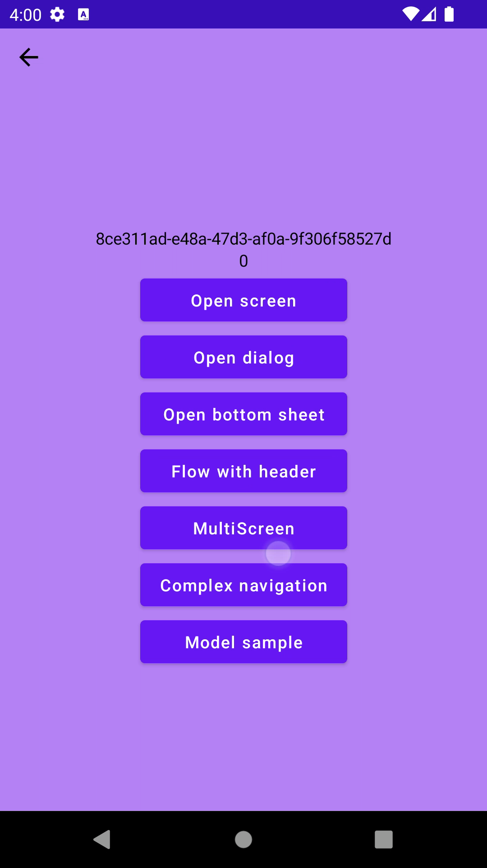
Modo: Граф экранов
StackScreen
Screen
Screen
MultiScreen
Screen
Screen
Screen

Slide 194
Можно установить
Произвольный State

Slide 195
Modo
1
Fragment
2
ContainerScreen/Screen
3
Навигируемся
4
NavModel/ContainerScreen
5
Поддержка анимаций, dialog

Slide 196
Modo: Animation
@Parcelize
internal class ModoStackScreen(
private val navModel: StackNavModel =
StackNavModel(SampleScreen(randomString())),
) : StackScreen(navModel) {
@Composable
override fun Content() {
TopScreenContent { SlideTransition() }
}
}

Slide 197
Modo: Animation
@Parcelize
internal class ModoStackScreen(
private val navModel: StackNavModel =
StackNavModel(SampleScreen(randomString())),
) : StackScreen(navModel) {
@Composable
override fun Content() {
TopScreenContent { SlideTransition() }
}
}

Slide 198
Modo: Animation
@Composable
protected fun TopScreenContent(
content: RendererContent<StackState> = defaultRendererContent
)

Slide 199
Modo: Animation
@Composable
protected fun TopScreenContent(
content: RendererContent<StackState> = defaultRendererContent
)
typealias RendererContent<State> =
@Composable ComposeRendererScope<State>.() -> Unit

Slide 200
Modo: Animation
@Composable
protected fun TopScreenContent(
content: RendererContent<StackState> = defaultRendererContent
)
typealias RendererContent<State> =
@Composable ComposeRendererScope<State>.() -> Unit
class ComposeRendererScope<State: NavigationState>(
val oldState: State?,
val newState: State?,
val screen: Screen,
)

Slide 201
Modo: Animation
@Composable
protected fun TopScreenContent(
content: RendererContent<StackState> = defaultRendererContent
)
typealias RendererContent<State> =
@Composable ComposeRendererScope<State>.() -> Unit
class ComposeRendererScope<State: NavigationState>(
val oldState: State?,
val newState: State?,
val screen: Screen,
)

Slide 202
Modo: Animation
@Composable
@OptIn(ExperimentalAnimationApi::class)
fun ComposeRendererScope<StackState>.SlideTransition() {
ScreenTransition(
transitionSpec = {
val transitionType = calculateStackTransitionType()
...
}
)
}

Slide 203
Modo: Animation
val transitionType = calculateStackTransitionType()

Slide 204
Modo: Animation
val transitionType: StackTransitionType =
calculateStackTransitionType(oldState, newState)

Slide 205
Modo: Animation
val transitionType: StackTransitionType =
calculateStackTransitionType(oldState, newState)
enum class StackTransitionType {
Push,
Replace,
Pop,
Idle
}

Slide 206
Modo: Animation
val transitionType = calculateStackTransitionType()
when {
transitionType == StackTransitionType.Replace -> {
scaleIn(initialScale = 2f) + fadeIn() with fadeOut()
}
else -> {
val (initialOffset, targetOffset) = when (transitionType) {
StackTransitionType.Pop ->
({ size: Int -> -size }) to ({ size: Int -> size })
else ->
({ size: Int -> size }) to ({ size: Int -> -size })
}
slideInHorizontally(initialOffsetX = initialOffset) with
slideOutHorizontally(targetOffsetX = targetOffset)
}
}

Slide 207
Modo: Animation
val transitionType = calculateStackTransitionType()
when {
transitionType == StackTransitionType.Replace -> {
scaleIn(initialScale = 2f) + fadeIn() with fadeOut()
}
else -> {
val (initialOffset, targetOffset) = when (transitionType) {
StackTransitionType.Pop ->
({ size: Int -> -size }) to ({ size: Int -> size })
else ->
({ size: Int -> size }) to ({ size: Int -> -size })
}
slideInHorizontally(initialOffsetX = initialOffset) with
slideOutHorizontally(targetOffsetX = targetOffset)
}
}

Slide 208
Modo: Animation
val transitionType = calculateStackTransitionType()
when {
transitionType == StackTransitionType.Replace -> {
scaleIn(initialScale = 2f) + fadeIn() with fadeOut()
}
else -> {
val (initialOffset, targetOffset) = when (transitionType) {
StackTransitionType.Pop ->
({ size: Int -> -size }) to ({ size: Int -> size })
else ->
({ size: Int -> size }) to ({ size: Int -> -size })
}
slideInHorizontally(initialOffsetX = initialOffset) with
slideOutHorizontally(targetOffsetX = targetOffset)
}
}

Slide 209
Modo: Animation
val transitionType = calculateStackTransitionType()
when {
transitionType == StackTransitionType.Replace -> {
scaleIn(initialScale = 2f) + fadeIn() with fadeOut()
}
else -> {
val (initialOffset, targetOffset) = when (transitionType) {
StackTransitionType.Pop ->
({ size: Int -> -size }) to ({ size: Int -> size })
else ->
({ size: Int -> size }) to ({ size: Int -> -size })
}
slideInHorizontally(initialOffsetX = initialOffset) with
slideOutHorizontally(targetOffsetX = targetOffset)
}
}

Slide 210
Modo: Animation
val transitionType = calculateStackTransitionType()
when {
transitionType == StackTransitionType.Replace -> {
scaleIn(initialScale = 2f) + fadeIn() with fadeOut()
}
else -> {
val (initialOffset, targetOffset) = when (transitionType) {
StackTransitionType.Pop ->
({ size: Int -> -size }) to ({ size: Int -> size })
else ->
({ size: Int -> size }) to ({ size: Int -> -size })
}
slideInHorizontally(initialOffsetX = initialOffset) with
slideOutHorizontally(targetOffsetX = targetOffset)
}
}

Slide 211
Modo: Animation
val transitionType = calculateStackTransitionType()
when {
transitionType == StackTransitionType.Replace -> {
scaleIn(initialScale = 2f) + fadeIn() with fadeOut()
}
else -> {
val (initialOffset, targetOffset) = when (transitionType) {
StackTransitionType.Pop ->
({ size: Int -> -size }) to ({ size: Int -> size })
else ->
({ size: Int -> size }) to ({ size: Int -> -size })
}
slideInHorizontally(initialOffsetX = initialOffset) with
slideOutHorizontally(targetOffsetX = targetOffset)
}
}

Slide 212
Modo: плюсы
1
UDF + простое изменение состояния
2
Корректность
3
Базовый набор команд как у Cicerone
4
Простота реализации внутри
5
Кастомизации (анимации, контейнеры и т.п.)

Slide 213
Modo: минусы
1
Обслуживающий код для Di
2
Немного boilerplate для экранов-контейнеров
3
Нет Bottom sheet
4
Всё ещё в разработке

Slide 214
Мы выбрали
MODO

Slide 215
Почему?

Slide 216
Почему не что-то другое?
1
Простота создания Screen
2
Экраны вложены в друг-друга на уровне моделей
(в Appyx сложнее)
3
Состояние - источник правды

Slide 217
Дальнейшие шаги
1
Завозить в реальные фичи проекта
2
Пример связывания с UDF framework (TEA, MVI)
3
Покрытие Modo UI тестами
4
Стабилизация диалогов
5
BottomSheet

Slide 218
HH Tech
https://t.me/hh_tech
https://t.me/hh_tech_news

Slide 219
Что мы сегодня узнали
1
Как работает rememberSaveable
2
4 классные библиотеки навигации
3
Каждая библиотека уникальна
4
Modo

Slide 220

Вопросики - Наброски

